Slide 1









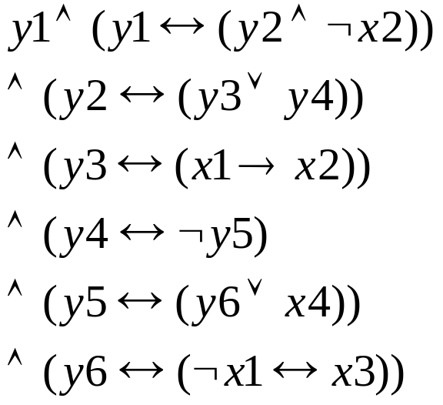








Circuit → Formula
Circuit
Minimum Spanning Trees

Slide 2
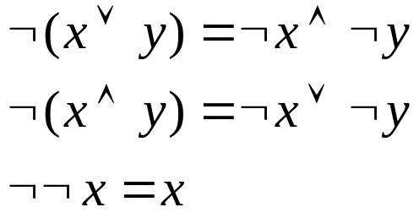
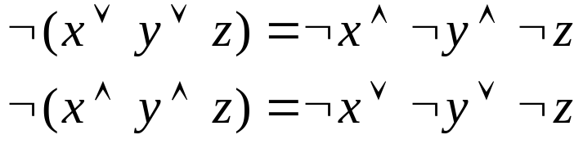
Logic
Demorgan Law:
Minimum Spanning Trees

Slide 3
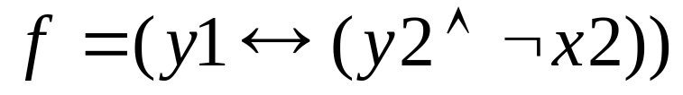
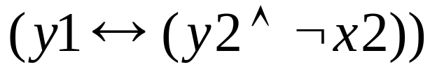
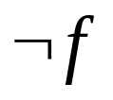
Truth table for
y1 y2 x2
1 1 1 0 1
1 1 0 1 0
1 0 1 0 1
1 0 0 0 1
0 1 1 1 0
0 1 0 0 1
0 0 1 1 0
0 0 0 1 0
Minimum Spanning Trees

Slide 4
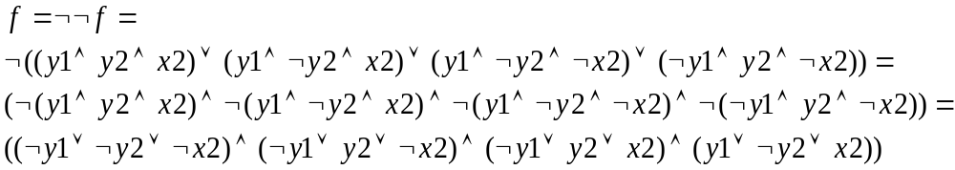
Convert to CNF
Conversion:
Minimum Spanning Trees

Slide 5
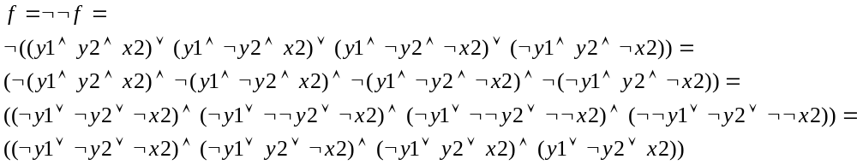
Convert to CNF
Conversion:
Minimum Spanning Trees

Slide 6
Problem: Convert Circuit C to Formula f such that C is satisfiable iff f is satisfiable. Need to introduce some new variables.
Circuit C
Minimum Spanning Trees

